Slide 1
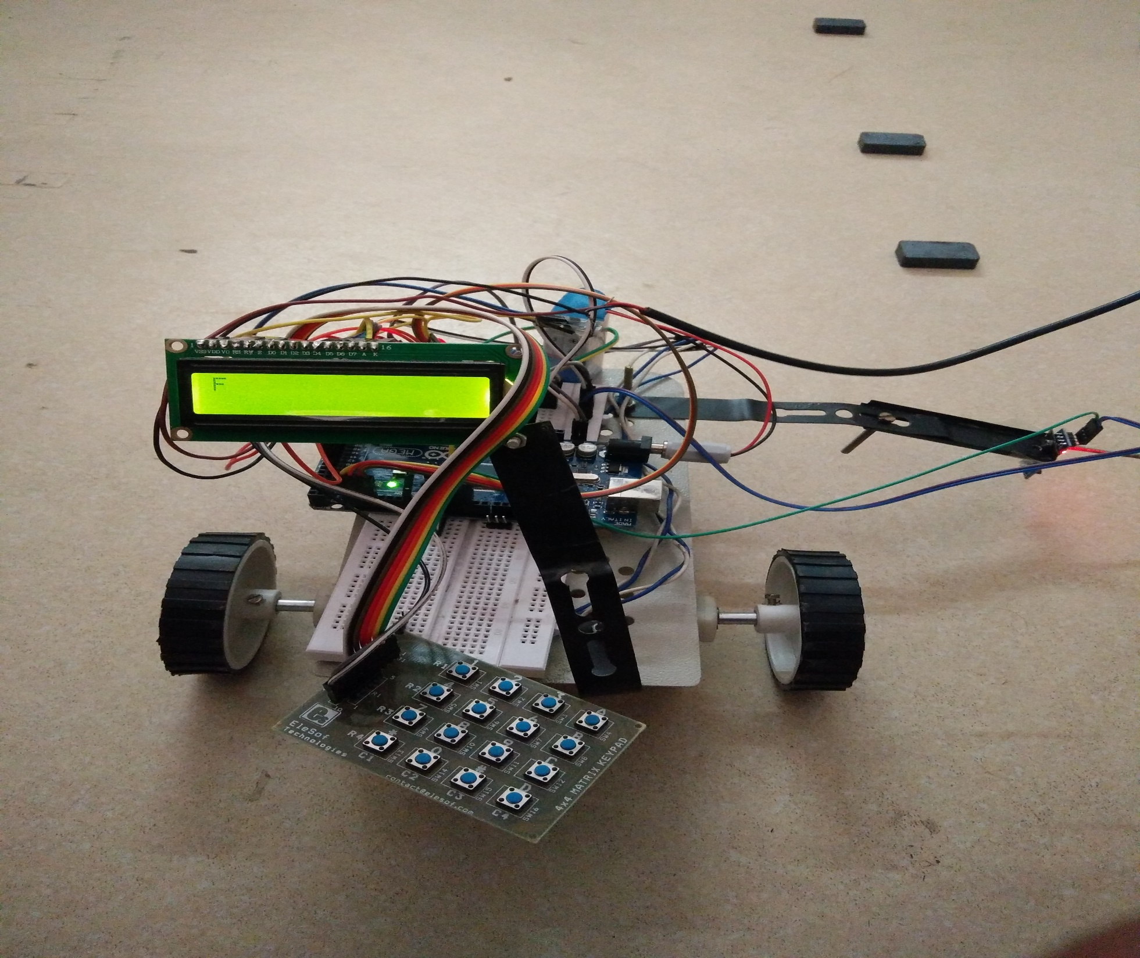

Slide 2
AUTOMATED CAB
(Based on Magnet and hall sensor).

Slide 3
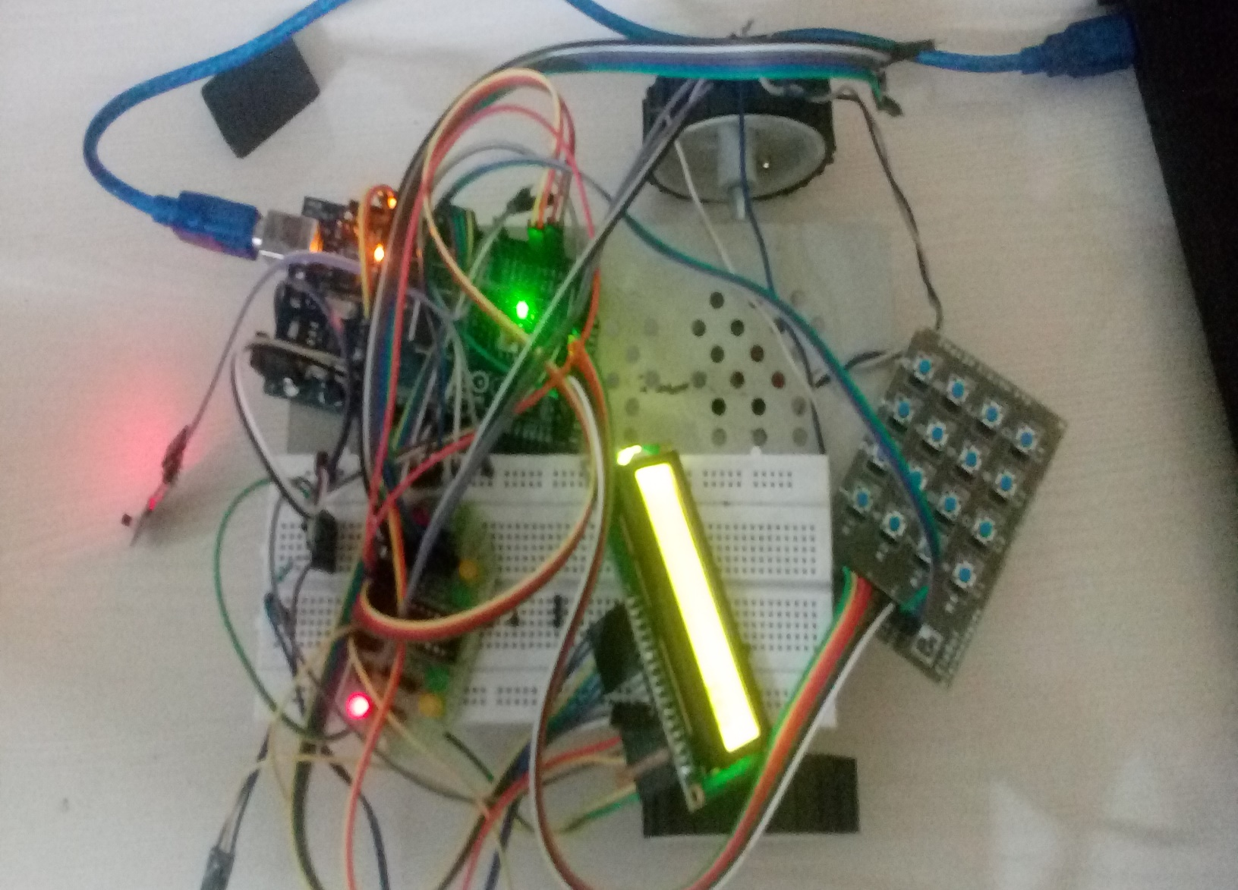
COMPONENTS USED
Motor drive IC L239D
Display 16*2
Gearhead Motors
Magnets
Hall Sensors
Arduino
Resistor, Variable Resistor
Jumper wire
Button, LED
Wheels, Chassis

Slide 4
Motor drive IC L239D
LCD 16*2
Motor drive IC L239D is a typical motor driver or motor driver IC which allows DC motor to drive on either direction.
L293D is a 16 pin IC which can control a set of two DC motors simultaneously in any direction.
The L293D can drive small and quite big motors as well.
LCD (Liquid Crystal Display) screen is an electronic display module and have wide range of applications.
A 16*2 LCD means it can display 16 characters in each line and there are 2 such lines.
In this LCD each character is displayed in 5*7 pixel matrix. It contains two registers.

Slide 5
GEARHEAD MOTORS MAGNETS
Gearhead motor was earlier used to change the motor speed and as a torque amplifier.
Now it is used for amplification of torque, improvement in permissible inertia and reduction of motor vibration and high accuracy positioning.
A magnet is an object that produces magnetic field.
It contain two poles i.e. South and North.
Opposite poles repel each other and similar poles attract each other

Slide 6
HALL SENSOR ARDUINO
A hall effect sensor is a transducer that varies its output voltage in response to a magnetic field.
In its simplest form, the sensor operates as an analog transducer directly returning a voltage.
Frequently, a hall sensor is combined with circuitry that allows the device to act in a digital mode, and may be called a switch in this configuration.
The Arduino is a microcontroller board based on the Atmega328.
It has 14 digital input/output pins, 6 analog inputs, a 16 MHz crystal oscillator, a USB connection, a power jack, an ICSP header and a reset button.
It differs from all other board in the way that it does not use the FTDI USB-to-serial driver chip. Instead, it features the Atmega8U2 programmed as a USB-to-serial convertor.

Slide 7
RESISTORS JUMPER WIRE
A resistor is an electrical component that limits or regulates the flow of electrical current in an electric circuit.
A variable resistor is a two terminal resistor with a sliding or rotating contact that forms an adjustable voltage divider.
It is a short electrical wire with a solid tip at each end which is normally used to interconnect the components in a breadboard.
They are used to transfer electrical signals from anywhere on the breadboard to the input/output pins of a microcontroller.

Slide 8
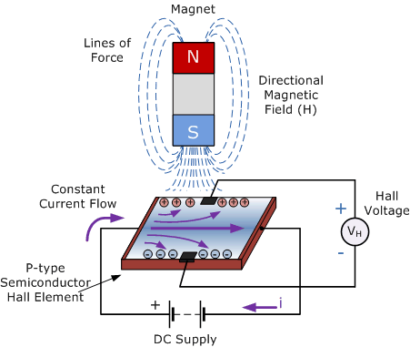
WORKING OF CAR
It is simply installed with hall sensor.
The track or path of the car is guided through magnets.
Through the sensor, the bot is supposed to sense the magnetic field of magnets.

Slide 9
Working Principle
Hall Effect Sensors are devices which are activated by an external magnetic field. We know that a magnetic field has two important characteristics flux density, (B) and polarity (North and South Poles). The output signal from a Hall effect sensor is the function of magnetic field density around the device. When the magnetic flux density around the sensor exceeds a certain pre-set threshold, the sensor detects it and generates an output voltage called the Hall Voltage, V_{H.}
This output voltage is used to direct the autonomous car and make it move forward.

Slide 10
Failures & Problems Faced
Reed switch got damaged due to which the cab now works only for one polarity.
Data transfer to LCD using R/W switch was not proper.
The processing was slow and time consuming on Arduino uno.
The car was very fast and was not able to sense some of the magnets.

